Slide 1

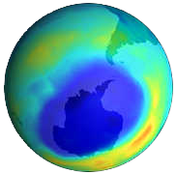
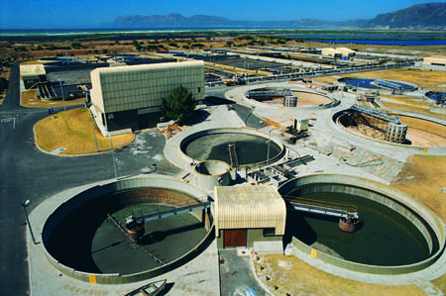

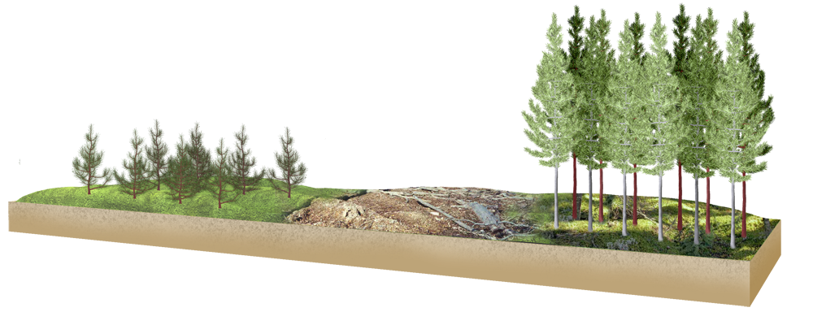

Ecology Series: Set 7
Copyright © 2005
Version: 1.0

Slide 2

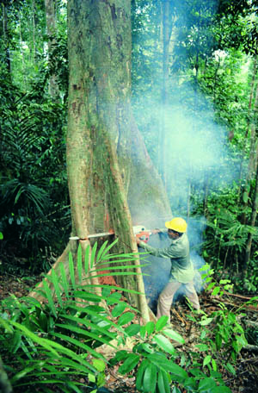

Human Impact on Resources
Human impact on the natural world has increased dramatically as the scope and intensity of human activities have increased.
  Unresolved problems include the loss of tropical forests, the buildup of ‘greenhouse’ gases and the loss of biodiversity.
Traffic on M25, UK
Tree felling, Philippines

Slide 3
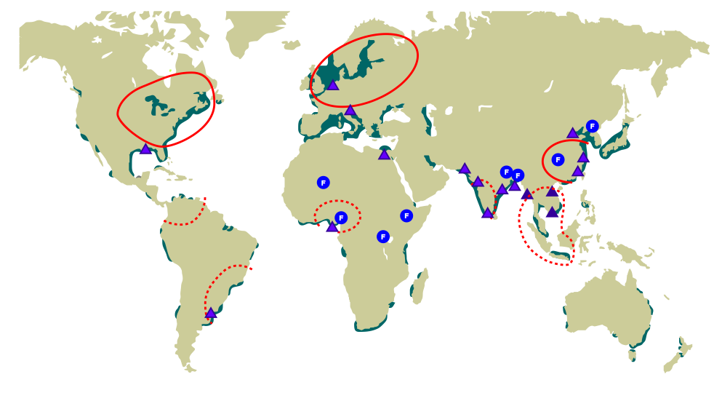





Global Human Impact
The impact of humans on the global environment is the result of resource use, rapid population growth, large population size and disproportionate distribution of resources.
Major famine since 1940
Area vulnerable to sea level rise
Area affected by acid rain
Area potentially affected by acid rain
Partial or severe coastal pollution

Slide 4

Human Population Growth
The world population, now at 6 billion, is growing at the rate of about 80 million per year.
Projections put the world population at between 8 and 12 billion in 2050, with nearly all of this growth expected in the developing world.
  Developing countries include: Africa, Asia (excluding Japan), Latin America and the Caribbean, and regions of Melanesia, Micronesia, and Polynesia.

Slide 5
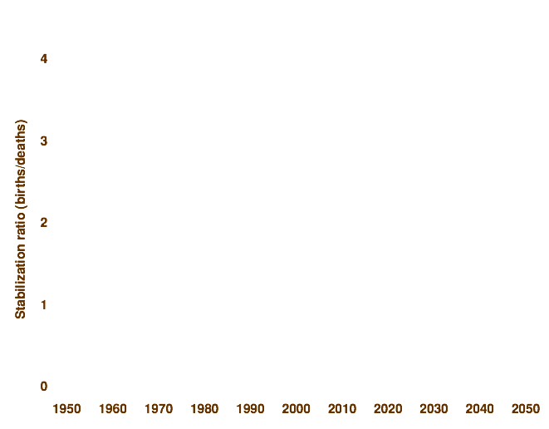
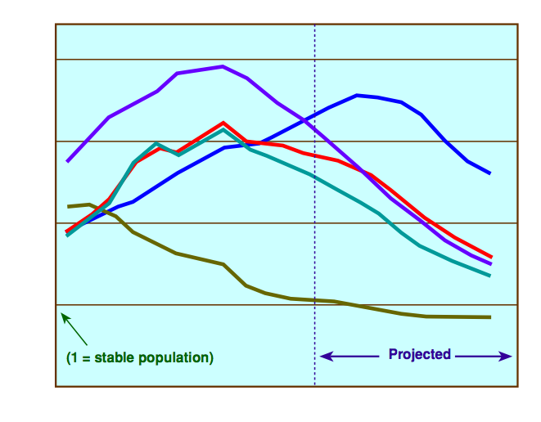
Population Stabilization
Human population growth is slower than predicted but because of the large and increasing population size the world population is still expected to increase substantially before stabilizing.
Progress Towards Population Stabilization
South & Central America
Africa
Asia
Developing
Developed

Slide 6
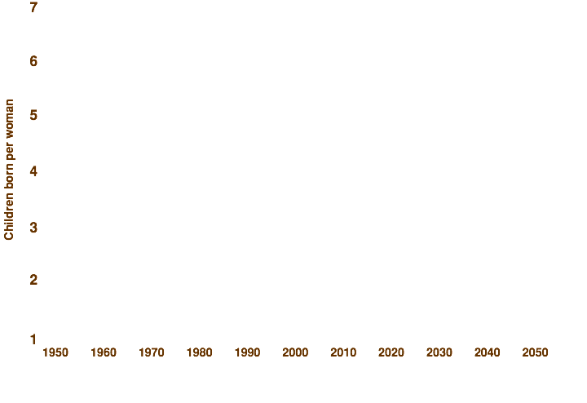
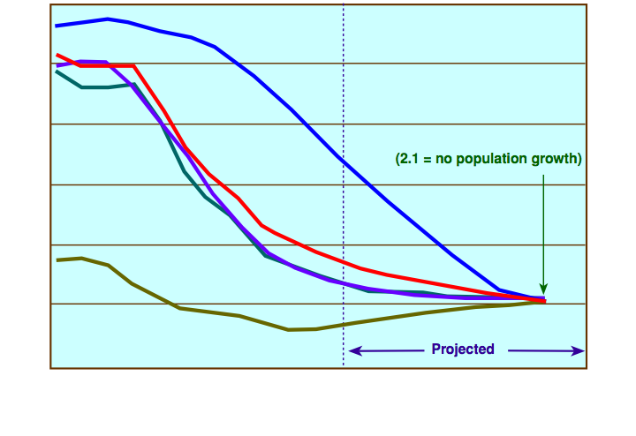
Fertility Rates
Based on current trends, it is assumed that human fertility rates will continue to decline and life expectancy will continue to increase. Developing countries are expected to broadly follow these demographic trends.
Trends in Fertility Rates
Africa
Asia
South & Central America
Developing
Developed

Slide 7
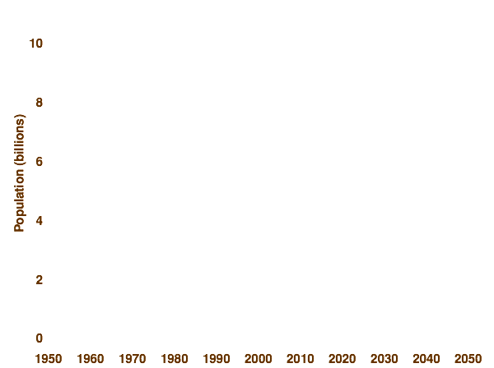
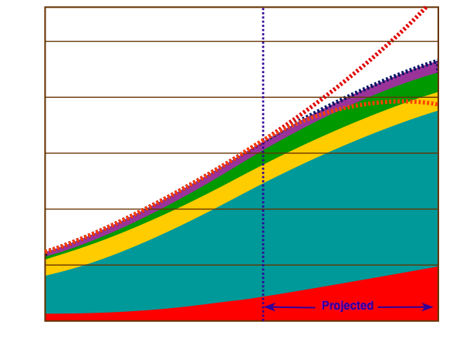
Global Population Growth
Estimates of likely future growth of the world human population are highly uncertain and projections for 2050 range from a low of 7.7 billion to a high of 11.2 billion.
Global Human Population Growth
North America
High fertility rate: 11.2 billion
Medium fertility rate: 9.4 billion
Low fertility rate: 7.7 billion
Latin America & Caribbean
Note: The latest ‘medium variant’ U.N. projection of 9.37 billion is nearly 500 million (4.7%) lower than the 9.83 billion projected in 1994.
Europe
Asia & Oceania
Africa

Slide 8
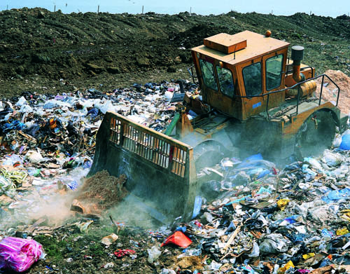
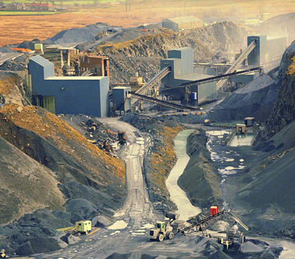
Global Issues 1
Consumption of natural resources by modern industrial economies remains very high, in the range of 45-85 tonnes per person annually.
  Each person in an industrialized society consumes many tonnes of raw materials each year. These must be extracted, processed, and disposed of as waste.
Bulldozer working on landfill site, UK
Limestone quarry, Yorkshire Dales

Slide 9
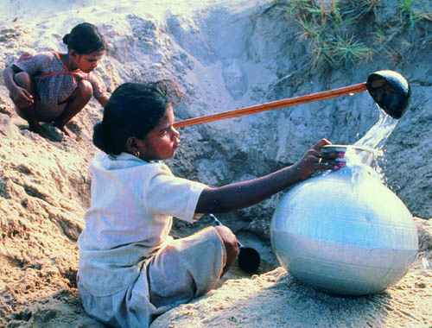
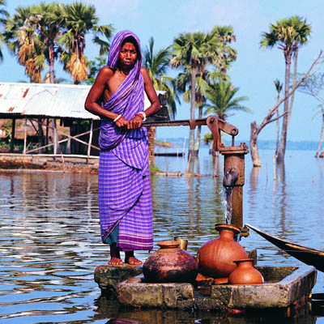
Global Issues 2
Global water consumption is rising rapidly. The availability, quality, and distribution of water is likely to become one of the most pressing resource issues of the 21st Century.
Global climate change due to the greenhouse effect will cause a rise in sea level and threaten coastal populations.
Collecting water, Udaipur, India
Flooded tube well, Bangladesh

Slide 10
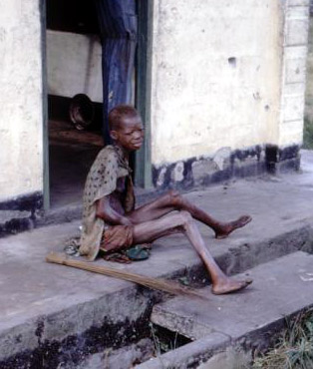
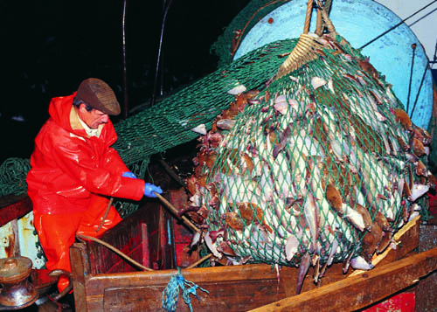

Global Issues 3
Although food production is generally adequate to meet human needs there are problems with distribution.
  Some 800 million people remain undernourished.
Overfishing of key fish stocks to levels where recovery is unlikely has occurred in many fishing grounds.
CDC: L. Conrad
Malnourished Nigerian refugee
Fisherman, North Sea

Slide 11
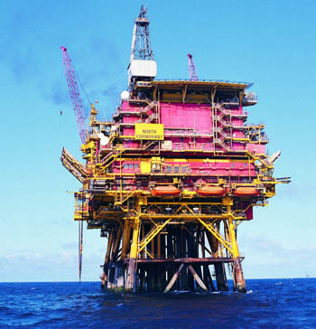
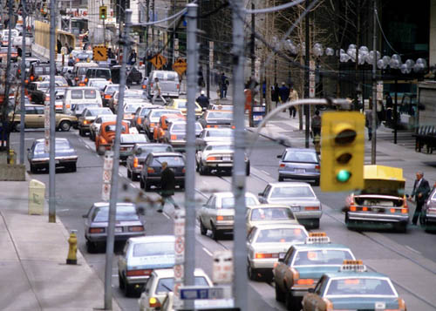
Global Issues 4
Global energy use has increased by 70% since 1970 and will increase 2% annually over the next 15 years.
Using fossil fuels will raise greenhouse gases by 50%.
Combustion engine emissions, plaguing the West with pollution, are increasing rapidly in Asia as their economies develop and become more affluent.
Oil platform, North Sea
Rush hour traffic, USA

Slide 12
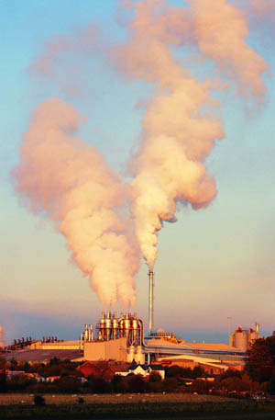
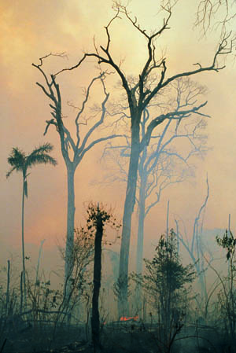
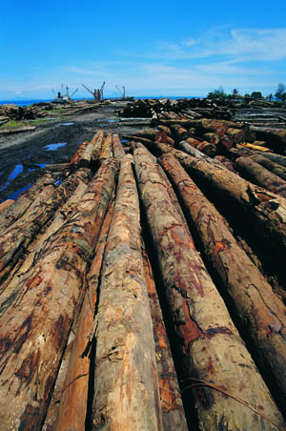
Global Issues 5
Air pollution contributes to global warming, ozone depletion, and acid rain, and it is set to increase markedly in some third world countries in the next thirty years. Some populous countries, such as China, are now entering a phase of rapid economic growth and increasing urbanization.
Forest fires and logging continue to reduce the extent of the world’s forests.
Cement factory, Scotland
Deforestation, Amazon
Logging site, PNG

Slide 13
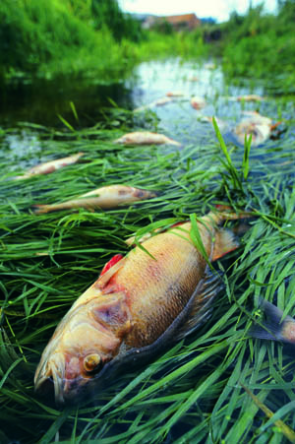
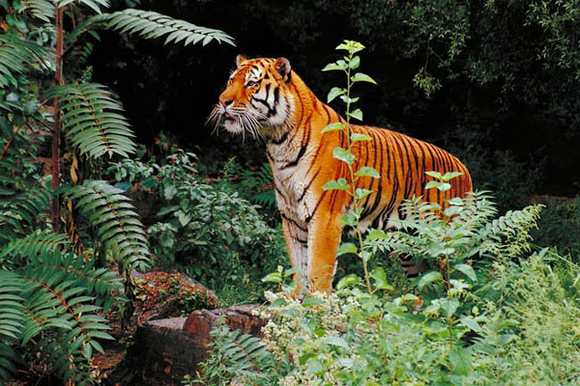
Global Issues 6
Treats to biodiversity from all sources are quickly reaching a critical level. Current extinction rates are 100 to 1000 times higher than prehuman levels.
Aquatic environments such as coral reefs and freshwater habitats in lakes, rivers and wetlands are all at risk of degradation.
Sewage pollution, UK
Bengal tiger, Panthera tigris tigris (endangered)

Slide 14
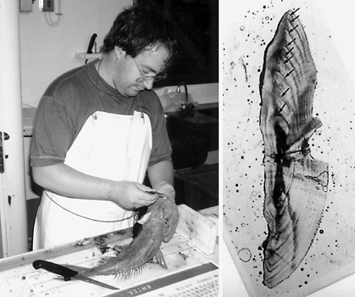
Gathering Resource Information
The impact of human activity on ecosystems is one of the primary concerns of the future, particularly given the high resource use of modern societies.
However, in order to make decisions about the impact of human activity on an ecosystem and its resources, it is necessary to have accurate scientific information about the ecosystem.
It is the role of scientists to:
  Gather baseline data on the
  ecosystem or its resources.
  Monitor changes in the
  resource once it is in use.
  Attempt to predict future
  changes in the ecosystem.
NIWA
Removing fish otoliths (right) for age analysis

Slide 15
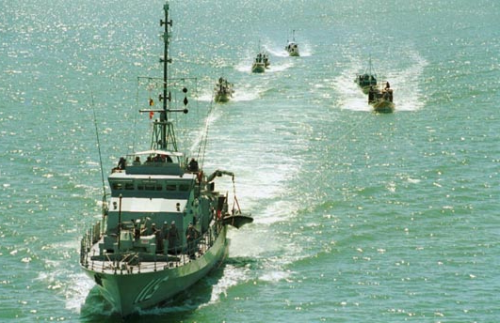
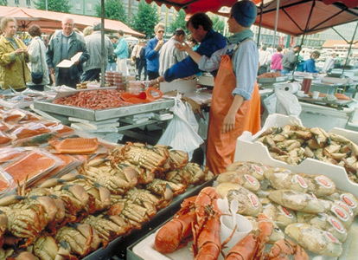
The Impact of Fishing 1
Fishing is an ancient human tradition that is now a worldwide resource extraction industry.
Several decades of overfishing in all of the world’s oceans has pushed commercially important species, e.g. cod, into steep declines from which recovery is unlikely.
  The maximum sustainable yield (MSY) has been exceeded by too many vessels catching too many fish, often using wasteful and destructive methods.
Fishing fleet
Fish market, Norway

Slide 16
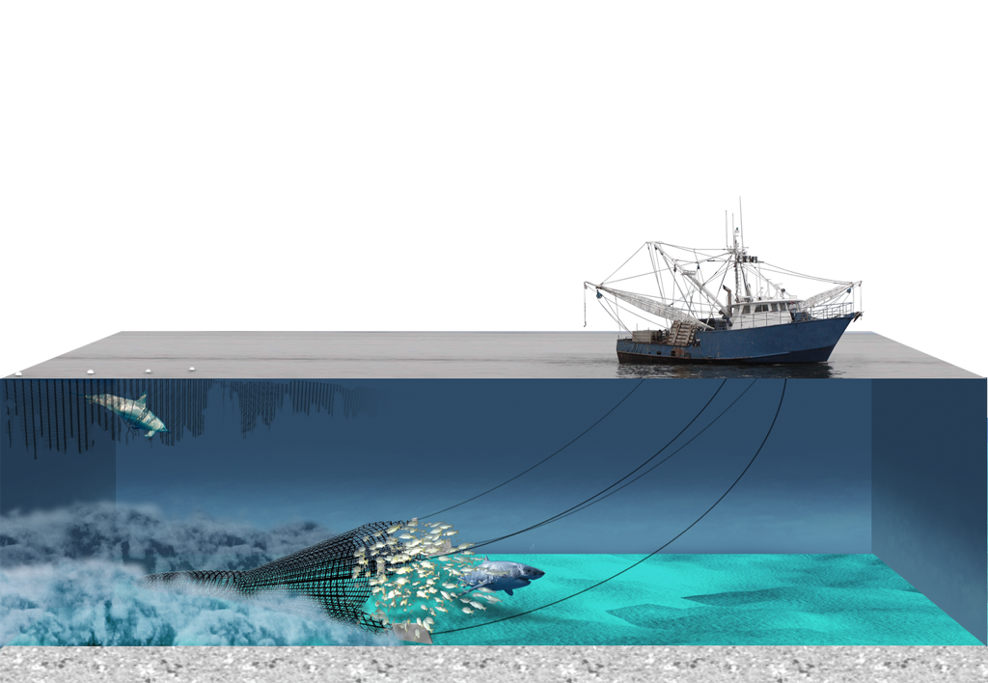
The Impact of Fishing 2
The build up of large scale fishing fleets has contributed to widespread overfishing and damage to the marine environment.
  Bottom trawls and dredges cause large scale physical damage to the seafloor. Sea mounts are particularly vulnerable.
  Lost fishing gear (particularly drift nets)
  threatens marine life, including birds and mammals.
Drift net
Purse seine

Slide 17
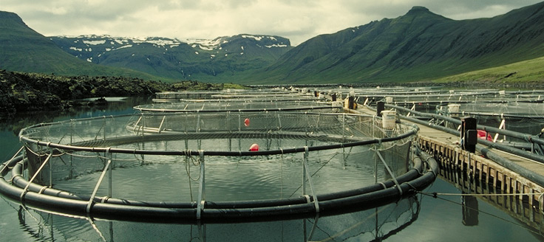
Fish Farming
Fish farming, once thought to be the solution to the world’s over-fishing problems, actually accelerates the decline of wild fish stocks.
  Many farmed fish are fed meal made from wild fish, but it takes about one kilo of wild fish to grow 300 g of farmed fish.
Some forms of fish farming destroy natural fish habitat and produce large scale effluent flows.
Salmon farming, Iceland

Slide 18
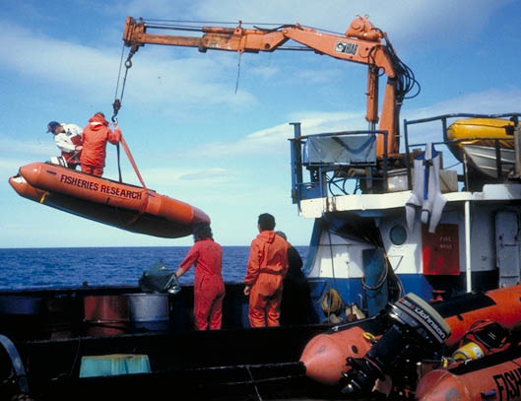
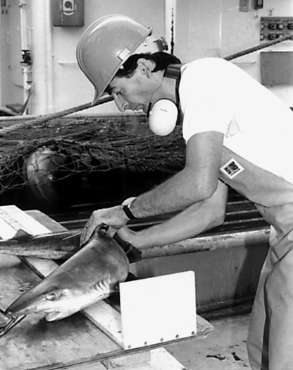
Managing Fisheries
The key features in fisheries management include:
  Developing an understanding of the resource before harvesting.
  A commitment to ongoing research into the biology of the fished species.
  Developing the safeguards necessary for sustainability.
  Consideration of human needs and demands.
NIWA
Surveying oyster beds, Fouveaux Strait, New Zealand
Shark tagging

Slide 19
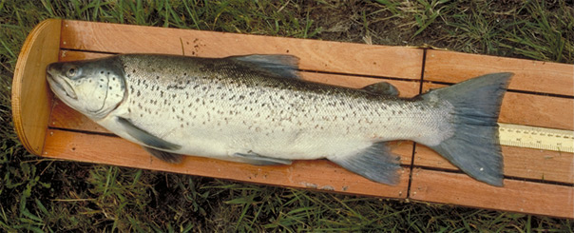

Stock Indicators
Stocks of commercially fished species must be managed to ensure that the catch does not undermine sustainability of the fishery.
This requires attention to stock indicators, e.g. catch per unit of fishing effort, stock recruitment rates, population age structure, and spawning biomass. Some definitions are important:
  Stock: The part of population from which catches are taken in a fishery.
  Stock recruitment: The entry of juvenile fish into the fish stock.
  Total Allowable Catch: The catch that can be legally taken from the stock.
  Stock collapse: Population level at which the fish stock cannot recover.
Measuring fish size as an indicator of age. Fish below size must be released.
Scallop measurer. Legal sized scallops must not pass through the rectangle.

Slide 20
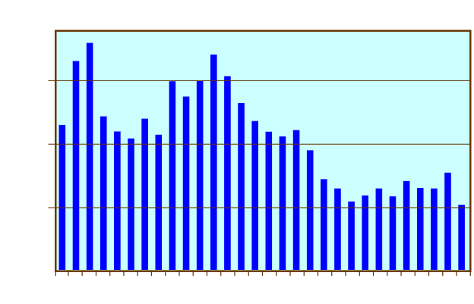
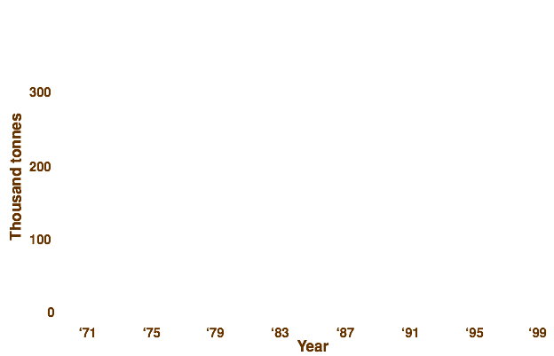
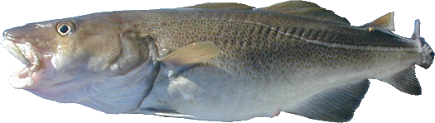
North Sea Cod Fishery 1
The stock of North Sea cod (Gadus morhua) is one of the world’s six large populations of this economically important species. As one of the most intensively monitored and exploited fish stocks in the North Sea, it is considered a highly relevant indicator of how well sustainable fisheries policies are operating.
The stock of North Sea cod is presently below safe biological limits and stocks are being
depleted in all
waters adjacent
to the North Sea,
where the species
is distributed.
Graph shows total international landings of North Sea cod. The decline in the take reflects the poor state of the stock.

Slide 21
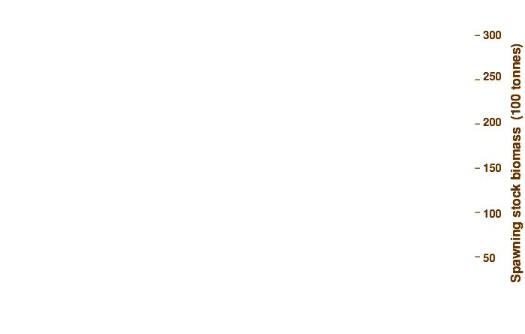
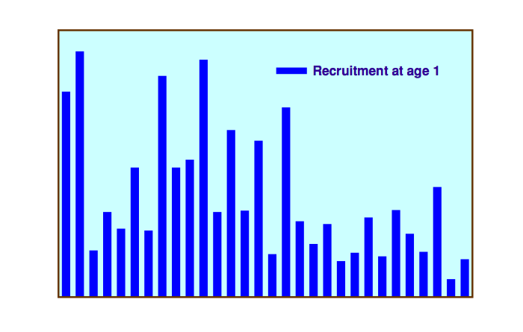
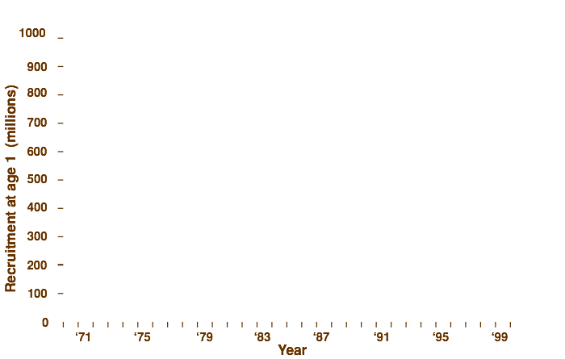
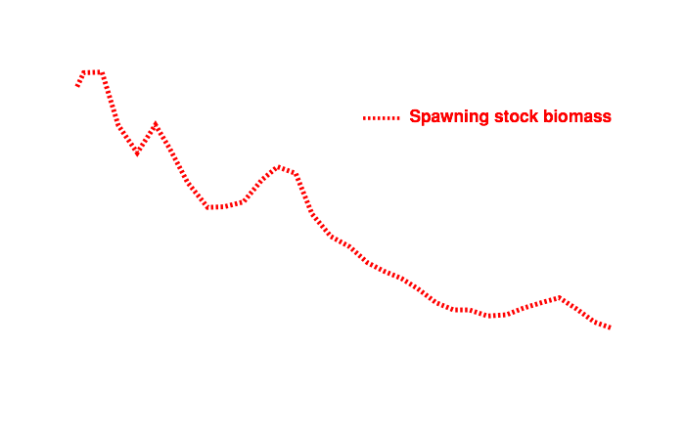
State of the Cod Fishery
The graph shows that recruitment has generally been poor since 1987, and the number of spawning adults has fallen to levels below those required to recruit new individuals into the stock.
Recruitment and Spawning Stock Biomass of North Sea Cod

Slide 22
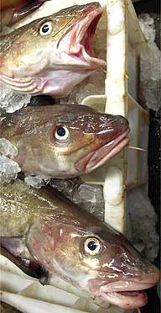
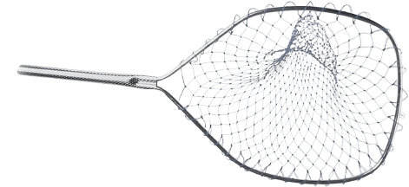
Cod Recovery Plan
ICES (the International Council for the Exploration of the Sea) advised that the spawning stock biomass (an indicator of the number of breeding adults) reached a new historic low in 2001, and that the risk of stock collapse is high.
ICES have recommended a recovery plan that will ensure recovery of the spawning stock to a level of more than 150 000 tonnes. Reductions in the TAC alone (it has been set at approximately half that set for the year 2000) are insufficient to stop the declines.

Slide 23
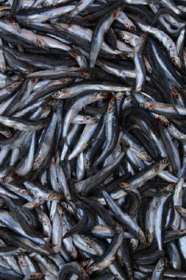
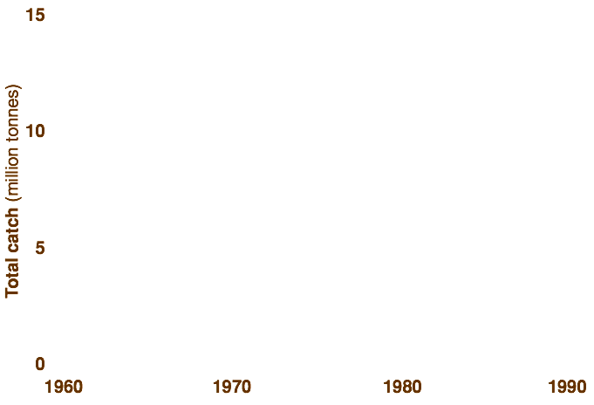
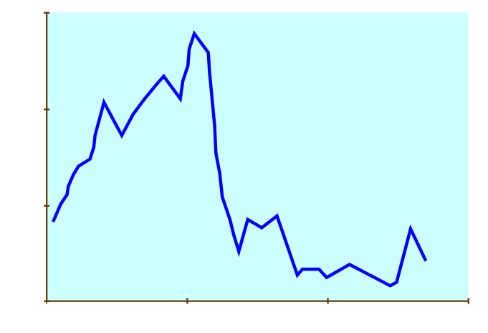
The Anchovy Fishery
The Peruvian anchovy fishery collapsed in 1972 due to a combination of environmental changes (El Nîno) and prolonged overfishing. The industry has never recovered.
Estimated maximum sustainable yield
Graph shows the annual catch of the Peruvian anchovy fishery, 1960-1990

Slide 24
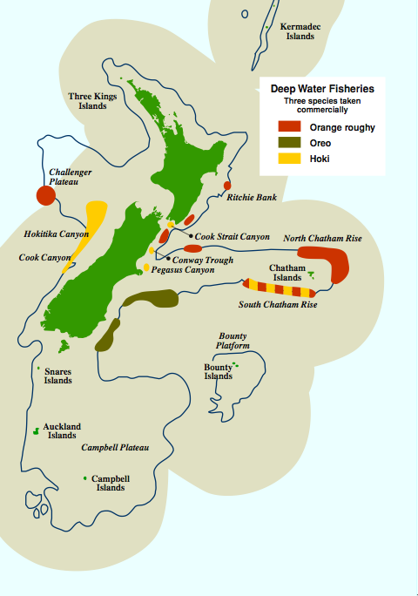
NZ’s Deep Water Fisheries
1000 m depth contour
The map shows where the fishing grounds are located for three of NZ’s most commercially important deep water finfish species.
  NZ’s Exclusive Economic Zone (EEZ) was set up in 1978 and extends 370 km offshore from the mainland and offshore islands.
  Despite the size of the EEZ (the fifth largest in the world), it is not an especially rich fishing ground by world standards.
Exclusive Economic Zone (EEZ)

Slide 25
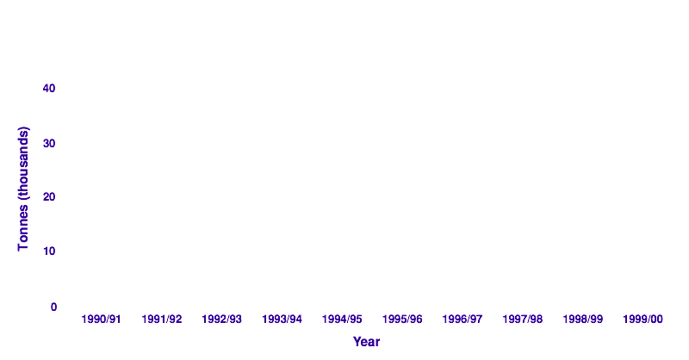
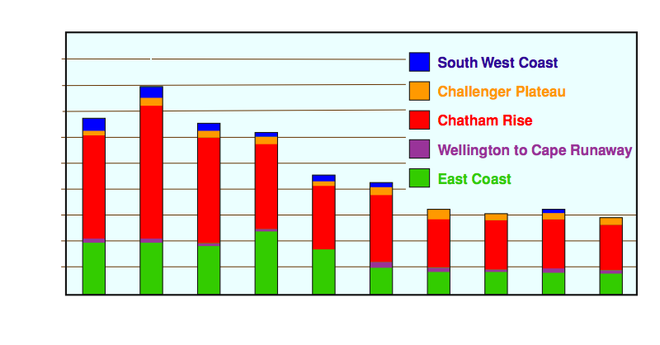
Orange Roughy Fishery
Since commercial harvest of orange roughy (Hoplostethus atlanticus) became established in New Zealand in 1979, the fishery has been declining. Quotas were introduced in 1986 but the fishery is regarded as fully exploited.
Annual commercial catch of orange roughy

Slide 26
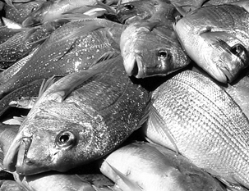
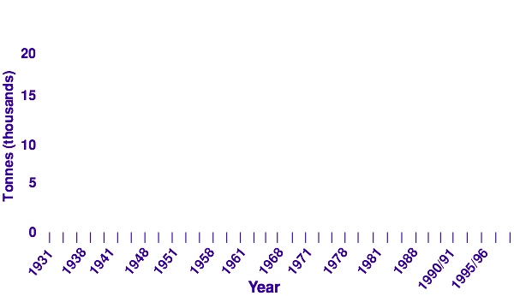
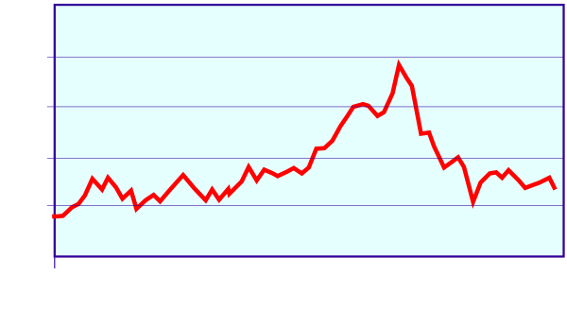
The Snapper Fishery
The snapper fishery in NZ has been controlled by a range of regulations and now, with a stock recovery program operating,
there are indications that the fishery may be slowly recovering.
  The graph shows the commercial snapper (Pagrus auratus) catch. Note that the changes reflect changes in snapper stock as well as the changes in Total Allowable Commercial Catch (TACC).
Commercial snapper catch, 1931-2000
NIWA

Slide 27



Gemfish Fishery
The decline of gemfish (Rexia solandri) in southern Australian waters represents a classic case of fisheries over-exploitation.
  The TAC was set at zero in 1993, but there is still considerable by-catch; the fishery has not recovered and may never do so.
  The records for the period prior to 1993, when commercial fishing ceased, show a decade of general decline in the gemfish stock.
Graph shows the commercial gemfish catch, 1970-1993

Slide 28




Rock Lobster Fishery
The rock lobster (Jasus edwardsii) has formed the basis of a major NZ inshore fishery for over 30 years. Rock lobster was added to the quota system in 1990 in response to the threat of fishery collapse.
  Fisheries scientists try to predict the collapse of the fishery given certain known catch rates. The figure below shows the probability of rock lobster fishery collapse by 1995 or 2001 based on the catch levels of 1991/1992.

Slide 29


Atmospheric Pollution
Air pollution comprises gases, liquids, or solids present in the atmosphere at concentrations high enough to harm living things or cause damage to materials.
  It does not only exist outdoors; the air enclosed in spaces such as cars and buildings may have higher levels of air pollutants than the outside air.
  Sick Building Syndrome occurs when air pollution inside a building causes a range of health ailments to the building’s inhabitants.
Pollution over Mexico City
Smoke from chimney stacks

Slide 30


Natural Processes
The activities of humans make a make a major contribution to global air pollution, but natural processes can also be responsible.
  Lightning causes forest fires, oxidizes nitrogen, and creates ozone.
  Volcanic activity releases toxic and corrosive gases.

Slide 31

Causes of Air Pollution
Photochemical smog
In the presence of direct sunlight, the mixture of pollutants from primary sources reacts to form ozone, nitric acid, PANs (peroxyacyl nitrates), and organic compounds such as formaldehyde.
Industry
Sulfur doxide SO2
Nitrogen dioxide NO2
Carbon monoxide CO
Hydrogen sulfide H2S
Dust, smoke
Volcanoes
Sulfur oxides
Carbon dioxide
Volcanic dust
Motor vehicles
Hydrocarbons HC
Nitric oxide NO
Carbon monoxide CO
Smoke and lead
Volcanoes and forest fires are a natural source of air pollutants
Emissions from power plants and industry, as well as burning fossil fuels
Petrol and diesel combustion engines
Methane from the belching and flatus of ruminants

Slide 32


Acid Rain
Acid rain (or more correctly termed acid deposition) can fall to the Earth as rain, snow or sleet, as well as dry, sulfate-containing particles that settle out of the air. It is a world-wide problem.
Sulfur dioxide and nitrogen dioxide are released into the atmosphere
Mix with water vapor to form acids
ACID RAIN
SO2 + NO2
H2SO4 + HNO3
Dry acid deposition
NO
Acid droplets dissolved in rain and snow
Nitric oxide given off as vehicle exhaust
Acid rain falling on land can enter water bodies as run-off
Emissions from power plants and industry
Vehicle emissions
Lakes become acidic

Slide 33







Acidity Tolerance
Acid rain produces forests with sickly, stunted trees and lakes that are so acid that they cannot support fish. It also releases heavy metals (for example, cadmium and mercury) into the food chain.
Changes in species composition of aquatic communities may be used as biological indicators measuring the severity of acid deposition.
  The graph shows the acidity tolerance
  of some common aquatic species.
Pasco

Slide 34

Water Pollution
Water pollution occurs as a result of contamination from sources ranging from urban and industrial to agricultural.
Some forms of pollution simply alter the physical state of the water, such as its temperature, pH, or turbidity, but others involve the addition of potentially harmful substances.
Pollutants may enter via:
  non-point sources where pollutants, such as
  agrichemicals, enter water bodies over large
  areas via groundwater and runoff.
  single or point sources where pollutants have
  been discharged into the environment through
  pipes, sewers, or ditches from specific sites.
Point source pollution

Slide 35


Inorganic Plant Nutrients
Fertilizer runoff from agricultural and residential land contributes inorganic plant nutrients, particularly nitrogen and phosphorus, to water bodies.
  This nutrient enrichment accelerates the natural process of eutrophication, and causes algal blooms and prolific aquatic weed growth.
  High nitrate levels caused by inorganic fertilizers are also toxic in drinking water, particularly for infants, small children, and pregnant women.
Excessive growth of filamentous algae
David Hamilton
Algal bloom and weed stranding, Lake Rotoiti, New Zealand

Slide 36


Eutrophication
Eutrophication is a term describing the enrichment of waters with nutrients. It often results in excessive growth of weed and algae.
Microorganisms decompose the organic matter in the polluted water and their activity increases the uptake of dissolved oxygen.
  This reduces the amount of dissolved oxygen available to other aquatic organisms and may subsequently cause their death.
Stock defecate and urinate into water bodies
Nutrient enrichment can lead to algal blooms

Slide 37


BOD
Biochemical oxygen demand is a measure of the polluting capacity of effluent where decomposition results in oxygen depletion.
BOD is measured as the weight (mg) of oxygen used by one liter of sample effluent stored in darkness at 20ºC for five days.
  When the BOD is high and dissolved oxygen levels are low. Anaerobic microorganisms also produce compounds with unpleasant odors. leading to a further deterioration in water quality.
Eutrophic (high nutrient) water frequently have a high BOD
University of Guelph, Canada
BOD study on waters entering and leaving the Guelph Water Treatment Plant

Slide 38


Sewage Pollution
Raw or partially treated sewage is a common water pollutant.
  Sewage pollution results from the disposal of household and industrial wastes into rivers, lakes, and seas. Most communities apply some treatment to raw sewage prior to discharge from point sources, but even treated sewage can be high in nutrients.
  Sewage is a source of pathogens (disease-causing agents). During floods, human waste may mix with drinking water and increase the risk of water-borne diseases such as cholera.
Raw sewage, UK
Flood waters, Bangladesh

Slide 39


Thermal Pollution
Thermal pollution of waterways is a common consequence of thermal power generation and water cooled industrial processes.
  Upstream, water is withdrawn, used for cooling, and then released downstream as a (heated) thermal plume.
  Restrictions are placed on the percentage of water removed for cooling and the temperature of the release water. However, the increased thermal load reduces oxygen levels and may compromise sensitive species.
Richard Allan
Brendan Hicks
Upstream of a thermal power station
Outlet of a thermal power station. Water is released over a stepped structure to increase cooling rate.

Slide 40

Radioactive Contamination
Radioactive materials can enter waterways from several sources, including mining and processing of radioactive minerals such as uranium and thorium.
  Radioactive substances are used by nuclear power plant and the nuclear weapons industries, but also by medical and scientific research facilities.
  Radiation may inadvertently
  escape from these facilities,
  polluting air, water, and soil.
  Accidents at nuclear power
  plants, such as Chornobyl
  (pictured), release into the
  atmosphere large quantities
  of radiation, which eventually
  contaminates soil and water.
Chornobyl, in the Ukraine, suffered a catastrophic explosion and fire in 1986.

Slide 41


Chemical Pollutants 1
Most of the thousands of organic water pollutants are synthetic chemicals created for human activities. These include pesticides, solvents, industrial chemicals, and plastics.
  Some organic compounds enter water sources directly or through seepage from landfills, through agrichemical runoff, or by leaching into groundwater.
  Oil pollution is particularly acute in harbors and shipping lanes. Oil damages aquatic systems because it spreads over water surfaces forming a film. It also coats organisms and is toxic when ingested.
Poorly managed landfills are a source of toxic leachate
Bird affected by oil spill

Slide 42


Chemical Pollutants 2
Inorganic chemical pollutants include mercury, road salt, and acid drainage. Most are toxic to aquatic organisms and their presence may make water unsuitable for drinking and other uses.
  Inorganic chemicals enter water courses from industrial plants, mines, irrigation runoff, oil drilling, and municipal storm drainage.
  Mercury is converted to methyl mercury
  compounds in sediments and readily
  enters food chains. It is highly toxic.
  Salt adversely affects drinking water and
  aquatic life.
  Mining exposes sulfur containing substances
  to the air, leading to acid (H2SO4) drainage.
Irrigation can lead to pesticide runoff
Mine drainage into a river, UK

Slide 43


Sediment Pollution
Sediment pollution comes from agricultural land, forest soils exposed by logging, overgrazed rangelands, strip mining, and construction.
  Suspended sediments increase turbidity and reduce light penetration. When they settle out, they smother aquatic organisms and reduce available habitat.
  Increased sediment loads may choke waterways and cause sediment buildup behind dams and in reservoirs.
Earthworks and quarrying increase sediment runoff
Stream erosion and sediment runoff

Slide 44


Detecting Water Pollution 1
The extent of water pollution can be determined in many ways:
  The nutrient loading can be assessed by measuring the BOD (the Biochemical (or Biological) Oxygen Demand).
  Electronic probes and chemical tests can
  identify the absolute levels of various inorganic
  pollutants (nitrates, phosphates, and heavy metals).
Oxygen meter
Stirrer
Pasco
Probe has a membrane across which oxygen diffuses

Slide 45


Detecting Water Pollution 2
The presence (or absence) of indicator species can give a biological indication of the pollution status of the waterway.
Different species have different tolerance levels to varying levels of pollution. Clean water communities are typically diverse, and species with high oxygen requirements predominate.
Communities in polluted or turbid streams are much less diverse and are dominated by species that are tolerant of low oxygen levels and sluggish water flows.
High diversity community
Stephen Moore
Low diversity community

Slide 46


Monitoring Water Quality
The quality of water in a stream, river, or lake is defined in terms of its various chemical, physical, and biological characteristics.
  Some measures of water quality cannot be made in the field and water samples must be transported to a laboratory for analysis.
  Telemetry stations transmit continuous measurements of the water level to a central control office.
Photos: Environment Waikato
Taking a water sample for later analysis
Telemetry station

Slide 47


Measuring Water Quality
The following measurements are routinely made by agencies involved in water quality monitoring:
  Dissolved oxygen and temperature (in the field)
  Clarity (in the field or the laboratory)
  Conductivity, pH, color, nutrients (nitrogen and phosphorus), major ions (magnesium, calcium, sodium, potassium, chloride, bicarbonate, and sulfate), organic carbon, and fecal bacteria (coliforms).
Photos: Environment Waikato
Taking water temperature
Assessing water clarity

Slide 48


The Waikato River
The Waikato River is the longest in NZ and runs through intensely populated regions, extensive farmlands and major industrial sites.
  The river is managed and monitored by Environment Waikato.
  The following slide shows the changes in water quality at different sampling points along the river, from its source at Lake Taupo (0 km) to Tuakau (290 km), near its estuary at Port Waikato (450 km).
Photos: Brendan Hicks
Huka Falls, near the Waikato River’s source, Lake Taupo
The Karapiro Dam

Slide 49





Waikato River Water Quality

Slide 50


The Rotorua Lakes
The Rotorua lakes, North Island, NZ, have been under increasing pressure from human activities for many decades. These pressures show up as a deterioration in lake water quality, with the development of cyanobacterial and green algal blooms.
  Environment Bay of Plenty conducts routine monitoring of the lakes, using a Tropic Level Index to track changes in water quality.
Photos: David Hamilton
Algal bloom, Okawa Bay, Lake Rotoiti. This popular boating spot is sometimes closed because of the blooms.
Cyanobacterial bloom, Lake Rotorua

Slide 51

Sewage Treatment
Sewage includes all waste water that has been used by a household or industry.
  It does not include stormwater from road and property runoff, which is usually diverted directly into waterways.
  In some cities, sewerage and stormwater systems may be partly combined, and sewage may overflow into stormwater during high rainfall.
Waste water treatment plant. Trickling filters are pictured in the foreground.
Sewage pipes discharging into a holding tank

Slide 52


Processing Sewage
Sewage usually undergoes several levels of treatment (purification):
  Primary treatment uses mechanical processes, such as screening and settling, to remove suspended sand and silt. This forms the primary sludge.
  Secondary treatment uses microorganisms to decompose the suspended organic material in the waste water. The bacteria-laden solids settle out as sewage sludge.
  Disinfection (usually by chlorination) kills any bacteria and other pathogens before the waste water is discharged.
  Tertiary treatment using biological, chemical, and physical processes is required to remove nitrogen, phosphorus, heavy metals, and synthetic organic compounds.
Sedimentation tank
Aeration tank: activated sludge

Slide 53

Sewage Treatment Plant

Slide 54

Global Warming 1
The Earth’s atmosphere comprises a mixture of
gases including nitrogen, oxygen, and water vapor.
Also present are small quantities of carbon dioxide, methane, and a number of ‘trace’ gases.
Global warming is a term generally used to describe the gradual increase in the average global temperature of the earth due to the increased levels of ‘greenhouse gases’.

Slide 55


Global Warming 2
Historically, the Earth’s climate has shifted between periods of stable warm conditions and cycles of glacials and interglacials.
  The current warmer period is partly explained by the recovery after the most recent ice age glacial period that finished 10 000 years ago.
  However, the current warming trend has been compounded by human activity, in particular, the release of certain greenhouse gases, such as carbon dioxide and methane, into the atmosphere.
Arctic iceberg
Ice floes, East Antarctica

Slide 56


Greenhouse Effect
The term ‘greenhouse effect’ describes the global climate warming caused by the release of greenhouse gases, which act as a thermal blanket in the atmosphere, letting in sunlight, but trapping the heat that would normally radiate back into space.
  About 75% of the natural greenhouse effect is due to water vapor. The next most significant is carbon dioxide.
Solar energy
Stratosphere
Build up of greenhouse gases
Troposphere
Earth’s surface
Solar energy is absorbed as heat by Earth and radiated back into the atmosphere
Most heat is absorbed by CO2 in the stratosphere and radiated back to Earth
Without its greenhouse gases, the Earth would be cold and inhospitable

Slide 57





Sources of Greenhouse Gases
Carbon dioxide (CO2)
  Car exhaust
  Combustion of fossil fuels
  Burning rainforests
Methane
  Belching and flatus of cows
Chlorofluorocarbons (CFCs)
  Leaking coolant from fridges and air conditioners
Nitrous oxide (N2O)
  Car exhaust

Slide 58


Effects of Global Warming 1
Coastal resources: The sea level is expected to rise by
50 cm by the year 2100.
  This is the result of thermal expansion in the ocean (water expanding as it warms) and by some melting of non-polar ice.
Forests: Higher temperatures and rainfall changes could increase the susceptibility of forests to fire, disease, and insect damage.
  A richer CO2 atmosphere will reduce transpiration in plants.
Sandbags, Thailand
Forest fire, Spain

Slide 59


Effects of Global Warming 2
Weather patterns: Under a warmer climate regime, regional changes in weather patterns such as El Niño and La Niña are likely. Changes in the intensity and frequency extreme weather conditions (storms and droughts) are also expected.
Water resources: Increased evaporation rates and changes in rainfall are predicted to affect the availability of water for irrigation, drinking, industrial use and hydroelectric power generation (photo, right).
Hurricane

Slide 60


Effects of Global Warming 3
Health: Higher temperatures over longer periods may result in distribution shifts and increase heat-stress mortality in susceptible organisms.
  Climate changes may produce new breeding sites for pests, e.g. mosquitoes, shifting the range of infectious diseases.
Agriculture: Climate change may affect the viability of staple crops, such as rice, in some regions, particularly the developing countries.
Anopheles mosquito: vector for the malarial parasite
CDC
Rice is a staple crop for many people

Slide 61




Changes in Atmospheric CO2
Since the industrial revolution and the expansion of agriculture about 200 years ago, additional CO2 has been pumped into the atmosphere.
  This build up of atmospheric carbon dioxide will continue to warm the earth during the twenty-first century.
Changes in atmospheric CO2 since 1000 AD
Changes in atmospheric CO2 since 1955
Expanded in detail in graph right. Note the change of scale.

Slide 62

Carbon Credits
Reducing carbon dioxide emissions is not easy as they are the end-product of fossil fuel combustion, and modern societies are powered by fossil fuels.
  The Kyoto Protocol is an international
  treaty on climate change. It aims to
  reduce greenhouse gas emissions
  through the creation of an international
  market in carbon credits.
  Countries can receive credits through
  various shared ‘clean energy’ programs
  and ‘carbon dioxide sinks’ in the form of
  forests and other systems that remove
  carbon dioxide from the atmosphere.
  These credits could be used to
  promote environmentally sensitive
  agriculture globally.
Wind energy does not produce CO2

Slide 63



Global Temperatures
The graph shows how the mean temperature for each year from 1860 until 2003 (pink bars) compared with the average temperature between 1961 and 1990. The smoothed curve shows the general trend indicated by the annual data.
Global Average Near Surface Temperature Annual Anomalies, 1860-March 2003
1998: the hottest year on record
Horizontal line represents the average temperature between 1961 and 1990. It provides a reference point for comparing temperature fluctuations.
Smoothed curve (mathematically fitted)
Note: Most anomalies since 1977 have been above normal, indicating that global temperatures are tracking upwards.

Slide 64

Tropical Deforestation 1
Almost half of the world’s rainforests are in just three countries: Brazil in South America, Zaire in Africa, and Indonesia in SE Asia.
During the 1990s, consumption of office paper in the USA nearly doubled.
Siberian forests are now a major source of timber for the USA and South Korean timber multinationals.
Japan is the largest importer of tropical hardwood, receiving 50% of the world’s supply.
Sources: National Geographic Atlas, 1996; The State of the Environment Atlas, 1995.

Slide 65


Tropical Deforestation 2
Rainforest clearance is taking place at an alarming rate as world demand for tropical hardwoods increases and land is cleared for agriculture. Because of the nature of the thin tropical soils, the resulting farmlands often have shortlived productivity.
Huge forest fires devastated large amounts of tropical rainforest in Indonesia and Brazil in 1997/98.
  The fires in Indonesia were started by attempts to clear the forest for farming in a year of particularly low rainfall.
Felling rainforest trees, Philippines
Burning rainforest, Amazon basin

Slide 66

Tropical Deforestation 3
Building new road networks into regions with tropical rainforests causes considerable environmental damage.
  In areas with very high rainfall, there is an increased risk of erosion and loss of topsoil.
Tropical deforestation results in considerable loss of biodiversity and contributes to global warming through a large reduction in net photosynthesis (loss of carbon sinks).
Bulldozer at work, Solomon Islands

Slide 67


Managing Woodlands
The United Kingdom was once largely covered with woodland, but over many centuries it was cleared to meet the needs of a growing population.
  Currently, only one tenth of the land area of the UK is covered by forest or other wooded areas but more than 80% of all forests are available for wood supply, with the remainder protected for conservation reasons.
  Careful management has made it possible to make use of the forest resource in a sustainable manner without destroying the particular features of the ecosystem.
Photo: David Craig www.strum.co.uk
Coppice remnant
Many of the UK’s woodland trees show signs of long term human management

Slide 68



Forestry Resources in New Zealand
NZ’s native podocarp forests are unique. They are remnants of an ancient forest type that once flourished on the supercontinent of Gondwana during the time of the dinosaurs.
NZ’s forests also comprise small discrete plantations of exotic species such as radiata pine and eucalypts. These were established last century, in part to reduce the pressure of milling native trees.
Agroforestry is becoming more common as farmers use the same land for both raising livestock and exotic forestry.
Remnant stand of native forest
Exotic radiata pine plantation
Agroforestry

Slide 69


NZ’s Forests
Defoliation: In the Kauaeranga Valley, possums have consumed 5-25% of the forest’s biomass in just 10 years.
The 70 million possums that now inhabit NZ’s forests are having a devastating effect. Together with the damage caused by deer and goats, they are responsible for an accelerated collapse of some of NZ’s native forests.
Dieback: A survey of rat-kamahi forest in Westland revealed 20% of all canopy trees were dead. 71% of the forest shows moderate to severe dieback.
Forest collapse: Hihitahi forest near Waiouru. A high altitude, wet conifer forest with remnant native cedar. About two thirds has been converted to scrub and most emergent trees have been defoliated by possums and deer.
Podocarp-mixed hardwood
The brushtail possum: an invader from Australia
Beech and beech-podocarp forest
Exotic plantation forest

Slide 70


Different Logging Methods
Different logging methods have different effects on the structure of a forest ecosystem. The two common methods used are:
  Clear-felling (or clear-cutting) results
  in the soil being exposed to erosion
  and less diverse regrowth.
  Selective logging has many variations,
  including a focus on particular species
  or thinning of small trees.
  Types of selective logging include
  harvesting:
    Single scattered trees
    Trees above a specified girth
    Selected groups of trees

Slide 71

Clear Cutting
A selection of mature forest is selected for removal based on tree height, girth, or species.
During clear cutting, the understorey is destroyed and a new forest of economically desirable trees may be planted.
  The trees may be of a single species and may even be clones.
A mature plantation forest is selected for harvesting
Seedlings of the same species are replanted
All the trees are removed

Slide 72

Selective Logging
Trees are selected for removal from a mature forest based on their height, girth, or species.
These trees are felled individually and directed to fall in such a way as to minimize the damage to the surrounding younger trees.
  Continual regeneration of young seedlings provides a balance of tree ages that mirrors the natural age structure.
Usually, the trees are repaced with seedlings of the same species
Mature trees are pre-selected for harvesting
The trees are removed with minimal disturbance

Slide 73

Coppicing
Coppicing is the ancient practice of harvesting wood for weaving, thatching, firewood, or for making charcoal.
  A selection of deciduous trees are coppiced (cut close to the ground) leaving stumps known as stools.
  Each stool subsequently regrows as many stems and it is these stems that provide the wood for harvesting in the future.
Many stems regrow from each stool
A mature deciduous forest is selected
The trees are coppiced

Slide 74


Stratospheric Ozone
Stratosphere
A thin veil of renewable ozone exists in a band of the upper stratosphere,
17-26 km above the Earth’s surface.
Stratospheric ozone absorbs about 99% of the harmful incoming ultra violet (UV) radiation from the sun and prevents it from reaching the Earth’s surface.

Slide 75

Effects of UV Radiation
As well as all the well known health problems associated with ultraviolet radiation, e.g. sunburn and cancers, UV-B radiation is likely to cause:
  decrease in the productivity of forests and surface dwelling plankton
  immune system suppression in animals
  lower crop yields
  increase in smog
  change in the global
  climate

Slide 76


Ozone Depleting Chemicals
The ozone depleting chemicals (below) drift into the stratosphere, where UV causes the release of highly reactive free chlorine.
  Chlorofluorocarbons (CFCs) are used in:
    coolants in fridges and air-conditioners
    propellants for aerosol cans
    styrofoam insulation and packaging
    medical sterilizers
  Halons are used in many fire extinguishers
  Methyl chloroform is used to degrease metals
  Methyl bromide is used as a fumigant
  Carbon tetrachloride is used in many industrial processes
Discarded refrigerators leak coolant
Many aerosols use CFC propellants

Slide 77



Ozone Depletion
Ozone layer
UV rays from the sun
Earth’s lower atmosphere
The destruction of ozone by free chlorine
Chlorine reacts with ozone
Life on Earth is shielded from the most damaging UV radiation by an absorbing layer of ozone in the stratosphere, 10-45 km above the Earth’s surface. Ozone depletion refers to reductions in stratospheric ozone below normal levels, after accounting for seasonal cycles and other natural effects.
UV light hits a CFC molecule and releases a chlorine atom
Chlorine oxide reacts with ozone

Slide 78

Dobson Units (DU)
The Dobson Unit (DU) is a measurement of column ozone levels (the ozone between the Earth’s surface and outer space).
The size and intensity of the ozone hole is growing each year, as can be seen in the satellite photos below. In recent years, a similar hole has developed over the Arctic.
  In the tropics, ozone levels
  are typically between
  250-300 DU year-round.
  In temperate regions,
  seasonal variations can
  produce large swings in
  the ozone levels and they
  can occur even in the
  absence of ozone depletion.
Monthly mean ozone, from the Southern Hemisphere

Slide 79


The Ozone Hole
In 2000, the extent of the ozone hole over Antarctica was the largest ever.
  The ozone ‘hole’ is defined as a region
  with lower than 220 Dobson units.
  The readings were taken between
  the South Pole (90 degrees south)
  and 40 degrees latitude.
  Data were collected in the
  Southern Hemisphere spring
  each year (between 7 September
  and 13 October.
The dark blue area indicates <200DU
Antarctic Ozone Hole, Minimum Values

Slide 80

Ozone Recovery
The problem of ozone depletion was first detected in 1984 when researchers discovered the region of thinner ozone over Antarctica.
  Since 1987, nations have cut their
  consumption of ozone-depleting
  substances by 70%.
Free chlorine in the stratosphere
peaked around 1999 and is projected
to decline for more than a century.
Ozone loss is projected to diminish
gradually until around 2050 when
the polar ozone levels will return to
1975 levels.
It will take another 100-200 years
for full recovery (to pre-1950 levels).

Slide 81

Agricultural Ecosystems
Agricultural ecosystems are highly modified ecosystems, which attempt to maximize the production of crop biomass by adding water and fertilizers.
  The ecological efficiency of such systems
  is generally low compared with that of
  natural ecosystems (e.g. swamps, estuaries).
Agricultural ecosystems may be:
  industrialized or intensive (high energy
  input) systems
  traditional (low energy input) systems
Industrialized farming practices are
generally non-sustainable because of
their high energy inputs. Traditional
farming relies more on sustainable
land use practices.
Monoculture of lettuce in an intensive farm

Slide 82

Intensive Agriculture
Intensive (industrialized) agriculture uses large amounts of fossil fuel energy, water, fertilizers, and pesticides to increase the net production (crop yield).
Plowing the land in front of an industrial plant, CA, USA

Slide 83


Advantages of Intensive Agriculture
Intensive crop production has a number of important advantages:
  Maximum yield from minimum land use; world grain production has almost tripled in the last 50 years.
  Yields increase more quickly and effectively than with alternatives.
  Mechanization reduce labor costs and leads to efficiencies of scale
  Per capita production has increased, reducing global hunger.
  The cost of food has declined, and more food is now traded globally.
Seeding (top) and planting (below): two practices once exclusively done by hand

Slide 84


Disadvantages of Intensive Agriculture
Despite its benefits, intensive crop
production has a number of drawbacks:
  Increases in yields may not be sustainable (per capita production is now decreasing)
  Pests and diseases spread rapidly in monocultures. Pesticide use is escalating yet its effectiveness is decreasing.
  Pesticides and fertilizers are energy expensive. Fertilizer use is increasing but soil and water quality continue to decline.
  Poor countries are reliant financially on outside assistance.
  Heavy machinery is expensive to purchase, operate, and maintain.
Intensive agriculture uses high inputs of energy to achieve high yields

Slide 85


Crop Harvest
Crop harvesting interrupts normal nutrient cycles and removes nutrients from the land. If the soil is left unreplenished it becomes nutrient deficient. The addition of fertilizers restores soil fertility.
  Organic fertilizers (carbon based) include animal manures, green manure, and compost.
  Inorganic fertilizers contain simple inorganic chemicals immediately available to the plant.
Because the soil is laid bare after harvest, erosion of topsoil occurs, with the loss of habitat for important soil organisms.
Harvesting strips biomass, and its associated nutrients, from the land
Soybean crop

Slide 86


Fertilizers
Nutrients lost through cropping can be replaced by the addition of fertilizers: materials that supply nutrients to plants.
Plants require a variety of minerals which are normally obtained from the soil. Minerals required in large amounts are called macronutrients (e.g. phosphorus, nitrogen, sulfur). Those needed in small amounts are called trace elements or micronutrients.
The use of fertilizers contributed to the world’s first green revolution, which greatly increased crop yields between 1950 and 1970.
Harvesting maize
Fertilizer application

Slide 87



Soil Nutrition

Slide 88

The Green Revolution
Since the 1950s, most increases in global food production have come from increased yields per unit area of cropland.
  This green revolution has been brought about through the development of high yielding crop varieties and the application of fertilizers, pesticides, and water.
The second green revolution has been taking place since 1967 with the introduction of fast growing dwarf varieties of rice and wheat specially bred for tropical climates.
The first ‘high input’ green revolution increased crop yields in most developed countries between 1950 and 1970
Major international agricultural research centers and seed banks
First green revolution (developed countries)
Second green revolution (developing countries)

Slide 89




Cereal Crop Production
The second green revolution is occurring in response to the use of fast growing, high yielding varieties of rice, corn, and wheat, specially bred for the tropical and subtropical climates.
Per capita grain production
Total world grain production

Slide 90

Global Wheat Production
Wheat (Triticum spp.) is the most important world cereal crop and is extensively grown in temperate regions.
Key areas for wheat production are the prairies of Canada and the USA, Europe, and Russia (the former Soviet Union wheat belt).
World production of wheat

Slide 91


Global Maize Production
The USA corn belt produces nearly half the world’s maize (Zea mays). Some is exported, but 85% is used within the USA as animal feed (as grain and silage). It is also a major cereal crop in Africa and second only to rice in importance in Asia.
Maize is poor in the essential amino acids tryptophan and lysine.
World production of maize

Slide 92


Maize
Maize grows well where temperature and light intensity are high, and its adaptations include:
  A slightly different biochemical pathway for photosynthesis than that in most cooler climate plants. This C4 pathway allows the plant to fix CO2 (even at low levels) as a 4C compound, which is used to boost CO2 levels for the regular C3 pathway. As a result, in warmer regions, C4 plants can achieve very high photosynthetic rates.
  Maize roots are shallow, so the plants often have small aerial roots at the base of the stem to increase their ability to withstand buffeting by wind.

Slide 93


Global Rice Production
Rice (Oryza sativa) is the basic food crop of monsoon Asia, and is highly nutritious. Both paddy and indica (upland) varieties are grown.
Most rice is grown in China, mainly for internal consumption. Other major producers include India, Pakistan, Japan, Thailand, and Vietnam.
World production of rice

Slide 94


Rice
Most of the rice in SE Asia is grown partly submerged in paddy fields. Its adaptations include:
  The stem has large air spaces running the length of the stem which allows oxygen to penetrate through the submerged roots.
  Shallow roots allow access to the oxygen that diffuses into the surface layer of waterlogged soil.
  When oxygen levels fall too low, the root cells respire anaerobically,
  producing ethanol. The root cells have a high tolerance to this
  normally toxic product.
Rice is a labor intensive crop. Planting (top) and irrigating (lower) are pictured.

Slide 95


Global Sorghum Production
Sorghum (Sorghum bicolor) is a nutritious grain used as a human foodstuff in Asia and Africa. In other regions it is used mainly as animal feed and as an industrial raw material (for oil, starch, and fiber).
Sorghum is widely cultivated in Africa, the middle East to India and Myanmar, and parts of Australia, the Americas, and Southern Europe.
World production of sorghum

Slide 96


Sorghum
Sorghum is able to grow well in the very hot, dry regions of tropical Africa and central India. Its adaptations include:
  The presence of special motor cells on the underside of the leaf that cause the leaf to roll inwards in dry conditions. This traps moist air in the rolled leaf and reduces water loss.
  A thick waxy cuticle and a reduced number of sunken stomata prevent evaporative water loss through the leaf surface.
  A dense root system that is efficient at extracting water from the soil.
Sorghum is well suited to tropical regions. Here workers (top) and an agricuturist (lower) inspect a crop.

Slide 97


New Crop Developments 1
Wheat has a selection of cultivars for particular nutritional qualities or high yield in local conditions. Research focuses on breeding hardy, disease resistant, and high yielding varieties.
Maize has high lysine hybrid varieties with better disease resistance and higher yields. Most countries have cultivars suited to local conditions.
Wheat
Maize

Slide 98


New Crop Developments 2
Rice has fast growing, disease resistant, high yielding cultivars which crop up to three times a season. Genetic engineering to increase the tolerance to high salinity is extending the range for cultivation.
Sorghum has high-yielding, low-growing and uniformly ripening new hybrids. Further breeding aims to improve grain quality and combine high yield properties with the disease resistance of the African wild stocks.
Indica (upland) rice
Sorghum

Slide 99


Global Soil Degradation
Especially in the tropics, deforestation, overgrazing, overcultivation, and poor irrigation practices can lead to desertification and salinization.
Major causes of worldwide
soil degradation
Overgrazing
Deforestation
Other agricultural activities
Other causes
35%
30%
27%
8%
Chemical contamination: In the United States, most farmers are dependent on heavy use of pesticides to maximize production.
Desertification: In Mali, the Sahara desert has expanded more that 650 km south in less than 20 years
Irrigation of farmland and deforestation in western and south eastern Australia have cause widespread salinization.

Slide 100

Soil Degradation
The following diagram shows the various ways soil damage may occur.
Chemical emissions
Heavy metals
and PCBs
Desertification
Industrial and vehicle emissions
Soil erosion
Soil exhaustion
Pesticides
Chemical dump
Salinization
Salt pan
Leaching
Toxic seepage
Rising water table through irrigation
Bedrock with high salt content

Slide 101


Chemical Contamination
Intensive agricultural practices, which call for high inputs of herbicides, pesticides, and fertilizers, can lead to a gradual deterioration of soil quality.
  Chemicals accumulate in the soil
  and enter ground water.
The problem of disposing of unwanted agrichemicals has reached major proportions in developed countries.
  Chemical dumps may be unstable: storage vessels deteriorate and
  their contents escape to enter
  ground and surface waters.
Orchard
Rice plantation
Intensive agricultural systems often rely on regular, heavy applications of agrichemicals.

Slide 102


Desertification
Desertification is a complex process involving multiple natural and human-related causes. In desertification, the productive potential of arid and semi-arid lands falls by 10% or more, and topsoil is lost or degraded.
  Desertification results mainly from a combination of natural climate changes causing prolonged drought and unsustainable human activities, including overgrazing and deforestation.
  Desertification may lead to the formation of a desert or the encroachment of an existing desert onto formerly arable land.
Overgrazing on marginal lands (top) can extend desert zones (lower)

Slide 103




Artificial Ecosystems
Humans can provide conditions that can maximize crop yield by:
  Providing enclosures, e.g tunnel houses and glasshouses.
  Regulating the abiotic factors important for growth, e.g. temperature, light intensity, and carbon dioxide concentration.
The effect of carbon dioxide concentration on plant growth
No growth
Enriched levels
Toxic

Slide 104

Hydroponics
Hydroponics is a technology for growing plants in nutrient solutions with or without the use of an artificial soil medium, such as sand or vermiculite, to provide support.
  Like all controlled-environment
  agriculture, it is expensive to
  establish and operate, but it is highly productive, conservative of water and land, and protective of the environment.
Hydroponic culture has been practised for centuries but it has been used on a commercial basis for only 40 years or so.
Hydroponics has been adapted to many diverse situations, including agriculture in Arctica (above), in space, and in non-arable regions such as deserts and coastal area.

Slide 105

Biosphere II
The Biosphere 2 Center (B2C) in Arizona is a controlled mini-world housing seven wilderness ecosystems, including a rainforest and an ocean, as well as a human habitat.
  Built by Space Biosphere Ventures, eight people were sealed inside it during 1991-92. All food was grown inside the facility and eventually oxygen was added to the air as the only outside input other than energy.
  In 1996 it was acquired by
  Columbia University as a
  research facility for examining
  how Earth’s biosphere will
  change as carbon dioxide and
  other substances build up in
  the atmosphere.

Slide 106


The Impact of Farming
Farming has had a negative impact on Britain’s rich biodiversity.
  Modern farming practices have greatly accelerated this decline and in recent years, active steps have been taken to conserve the countryside.
  For example, hedgerow legislation incorporates policies to increase woodland cover and schemes to promote environmentally sensitive farming practices.
Farmland, Shropshire
Hedgerow running beside road

Slide 107

The Hedgerow Issue
The conversion of many traditional, mixed farms, which required hedgerows to contain livestock, have been converted to arable farms with large fields to accommodate modern machinery.
  In Britain, this conversion has resulted in the loss of thousands of kilometers of hedgerows each year.
Hedgerows are ecologically important because they increase the diversity of wildlife by:
  Providing food and habitats
  for birds and other animals.
  Providing habitats for predators
  of pest species.
  Acting as corridors for animals
  to move along.

Slide 108


Traditional Farming
Traditional farming, such as that practised by the Amish people of Pennsylvania, USA, uses low-input agricultural methods similar to those used in modern organic farming.
Currently, low input agriculture occurs on less than 1% of the world’s cropland (0.2% in the USA, but 6-10% in parts of Europe), but this type of farming is growing rapidly.
Traditional farming practices are sustainable in the long term and improve soil health and fertility.
Amish farm, USA
Plowing rice field, Bangladesh

Slide 109



Sustainable Agriculture
The components of sustainable, low input agriculture are applicable to any type of cropping or harvesting system.
High yield polyculture
Organic fertilizers
Biological pest control
Integrated pest management
Irrigation efficiency
Perennial crops
Crop rotation
Use of more water-efficient crops
Soil conservation
Subsidies for more sustainable farming and fishing
Soil erosion
Salinization
Aquifer depletion
Overgrazing and overfishing
Loss of biodiversity
Loss of prime cropland
Food waste
Population growth
Poverty
Subsidies for unsustainable farming and fishing
More
Less

Slide 110


Advantages of Organic Farming
The advantages of organic farming include:
  Farmers can still make use of new high yielding crop varieties (right).
  Produce is pesticide free and produced sustainably.
  Crop type is more closely matched to the appropriate season and soil.
  It increases crop diversity and disrupts disease and pest cycles.
  It improves soil quality and structure, reducing nutrient and water loss.
Traditional haymaking, Ireland

Slide 111


Disadvantages of Organic Farming
Organic produce
The disadvantages of organic farming include:
  Yields are lower and more land is required for the same yield.
  Produce may be more expensive to buy, of reduced quality and with a shorter shelf life. Consumer choice may be restricted if out of
  season.
  There may be considerable bacterial contamination of produce due to high use of manures.
Muck spreading

Slide 112


Crop Rotation
Crop rotation is a farm practice where crops with different nutrient demands are cultivated in succession on the same ground in successive years.
Its purpose is to maintain soil fertility and reduce pest infestation. This avoids the need for chemical pesticides.
A typical rotation is of three to six years. Legumes (e.g. clover, beans) are important in the rotation as they restore nitrogen to the soil. These alternate with root and cereal crops.
Crop of soybeans. Legumes fix atmospheric nitrogen and restore soil nitrogen.
Barley and other cereal crops are commonly part of a rotation

Slide 113

Conservation Tillage
Conservation tillage describes the practice of leaving crop residue in place and mixing it into the surface layers of the soil. Conservation tillage improves the soil structure through aeration and returns nutrients to the soil.
  It is best suited to crop rotations where the crop residue changes seasonally. In continuous cropping systems, conservation tillage leaves the same type of residue in the soil all year round, and this may harbor pests and disease.
Tilling prepares the land for crop sowing, in this case, potatoes

Slide 114

Managing Grasslands 1
Natural grasslands are diverse and productive ecosystems, but currently cultivated grasslands may contain as few as three species.
In order to conserve grassland ecosystems, management practices that promote grassland species diversity must be implemented, even though many of these practices often conflict with modern farming methods.
The use of fertilizers reduces species diversity. Keeping soil fertility low allows desirable grassland species to better compete with the more aggressive grasses.
If grassland is not grazed, it will quickly turn to scrub and woodland
Moderate grazing allows slower growing species to compete with the grasses
The practice of plowing fields and reseeding grass mono-cultures should be avoided

Slide 115


Managing Grasslands 2
The increase in urban sprawl and the pressure on farmers to increase the productivity of their land and are having a detrimental effect on the once common flowering plants of Britain’s grasslands.
  Conservation of grasslands is not only important for maintaining plant diversity. Many birds, reptiles, invertebrates, and mammals also rely on these ecosystems for food and shelter.
Grouse
Daisies

Slide 116

Integrated Pest Management
Integrated pest management (IPM) describes pest control practices where each crop and its pests are evaluated as part of an ecological system. A program is developed that includes crop management
(e.g. intercropping), and biological and chemical controls.
  The aim is not to eradicate pest
  populations, but to reduce crop
  damage to an economically
  tolerable level.
An increasing number of pest
control experts and farmers
believe IPM is the best way to
control crop pests.
Intercropping: peas and corn

Slide 117


Stages in IPM
IPM involves several phases. Crop management and monitoring of pest levels are ongoing. When crop damage becomes unacceptable, farmers implement the following control measures in sequence and with the proper timing.
  Stage 1: Cultivation controls, such as hand weeding and vacuuming crops to remove insect pests.
  Stage 2: Biological controls, such as pheromone traps, and natural predators, parasites, and disease organisms.
  Stage 3: Targeted pesticide use (chemical controls), mostly based on natural insecticides. Different chemicals are used to slow the development of resistance.
Hand weeding
Cereal Research Centre, AAFC
Pheromone trap

Slide 118


Biological Pest Control
Biological control (biocontrol) is a management tool for controlling pests using parasites, predators, disease organisms.
Control agents with a botanical or microbial origin (e.g. Bt toxin) are classified as biopesticides.
Biological control is an important part of IPM but it is not risk free. Some biocontrol agents may even become pests themselves. The cane toad (right) was introduced to Australia to control gray cane beetle and is now a major threat to native wildlife.
Ladybirds are voracious predators of aphids
Cane toad
Photo: Ian Smith

Slide 119


Biocontrol of Whitefly
Adult whitefly resemble tiny moths. The young appear as scales on the undersides of many glasshouse crops where they suck the sap.
Two biocontrol agents are in common use: the ladybird Delphastus, which feeds on eggs and larvae, and the parasitic wasp Encarsia.
Both adult and larval Delphastus feed on whitefly; individuals may consume 150 whitefly eggs a day.
Controls
Photos: Dr John Dale, Defenders Ltd
Ladybird (Delphastus)
Ladybird (Delphastus)
Whitefly (Trialeurodes vaporariorum)

Slide 120


Biocontrol of Prickly Pear
Prickly pear cactus (Opuntia stricta) was introduced to Australia as an ornamental plant in the 1800s. It dispersed rapidly to cover an estimated 250 000 km² by 1925, much of it so densely that the land could not be used.
The caterpillar of the moth Cactoblastis cactorum is a natural enemy of the prickly pear cactus and, as a biocontrol agent, it succeeded in clearing the 250 000 km² of prickly pear cactus over several years.
Controls
Photo: Dept of Environment, Queensland
Cactoblastis cactorum
Prickly pear cactus (Opuntia stricta)

Slide 121


Biocontrol of Scotch Thistle
The scotch thistle (Onopordum acanthium) was accidentally introduced into Australia from Europe. The seeds survive in soil for more than 20 years and are distributed by livestock which have spread this weed across 1 million hectares of Australian farmland.
  The biocontrol program, launched in 1987, involves three established weevil species, each of which attacks a different part of the thistle: flower head, stem, or rosettes. This multi-pronged approach offers effective control.
Controls
Photos: Dept of Environment, Queensland
Adult thistle weevil (Larinus latus)
Scotch thistle

Slide 122


White-spotted Tussock Moth
A relative of the gypsy moth, the tussock moth (Orgyia thyellina) has been accidentally introduced from Asia to Canada, the USA and, recently, New Zealand. The larvae from the tussock moth have the potential to destroy forestry and horticultural industries in areas where they become established.
  Affected areas are sprayed with Foray 48B, containing the toxin of the naturally occurring soil bacteria, Btk (Bacillus thuringiensis var. kurstaki). Biocontrols have had mixed results in North America, but early aggressive control measures in NZ appear to have successfully eradicated the moth.
Controls
Photo: Jane Roskruge
Bacillus thuringiensis
Tussock moth (female)

Slide 123


Biocontrol of Brushtail Possums
The brushtail possum (Trichosurus vulpecula) was first liberated into forests in New Zealand in 1858. Further numerous releases were made between 1890 and 1900 by acclimatization societies to establish a fur trade. The population has since increased to 70 million, and they have devastated New Zealand’s flora and fauna.
A biocontrol control based on the immune-rejection of sperm by females, is still being investigated.
Controls?
Photo: Forest and Bird, NZ
Vaccine based immune-rejection of sperm
Brushtail possums

Slide 124


European Rabbit Control
The European rabbit (Oryctolagus cuniculus) has reached plague proportions in parts of Australia and New Zealand.
  Early attempts at biological control involved the Myxoma pox virus (introduced in the 1950s). This was ineffective in the long term.
  Calicivirus (the infective agent for Rabbit Hemorrhagic Disease or RHD) escaped from quarantine in Australia in 1995 and then spread both naturally and with assistance. It was introduced illegally into New Zealand in 1997, although at the wrong season for maximum effect.
Like all viruses, Calicivirus
attenuates (loses virulence)
in the field. The efficacy of
control is variable and
depends on the age
structure of the infected
population.
Controls?
Calicivirus
European rabbit

Slide 125

Effects of Biocontrol
The European rabbit (Oryctolagus cuniculus) was successfully introduced into Britain by the Normans for their meat and fur.
By the 1950s, they were considered a pest. The introduction of the Myxoma virus killed 99% of Britain’s rabbit population. The cascade effects of this event are still evident today.
1950s
1980s-1990s
High rabbit numbers (60-100 million)
Longer grasses and shrubs invade and predominate
Rabbit numbers low
Vole populations increase
Foxes prey switch to voles
Grazing pressure maintains grassland, no colonization by shrubs.
Wildflower and herb species benefit.
Myxomatosis epidemic
Sporadic outbreaks of myxomatosis:
rabbit numbers remain low
Serious decline in the abundance of wild thyme
Serious decline in certain Myrmica species of ant
99% mortality
Grazing pressure removed
Predators increase due to high levels of available carrion
Numbers of hares increase
Local extinction of large blue butterfly
The butterfly’s life cycle depends on both thyme and Myrmica

Slide 126


The Cane Toad
The introduction of the cane toad (Bufo marinus) to control the gray cane beetle (Dermolepida albohirtum) in Australia was spectacularly unsuccessful and the beetle continues to be a pest of sugar cane crops in Northern Australia.
  The cane toads have a voracious appetite for a wide variety of prey and compete with native species for food and habitat.
  In the absence of natural predators and parasites, cane toad populations have reached ten times the densities found in Venezuela.
Gray cane beetle, Dermolepida albohirtum
Cane toad, Bufo marinus

Slide 127


Toxins in the Environment
Certain substances in the environment are harmful when absorbed in high concentrations. These substances include:
  Pesticides
  Radioactive isotopes
  Heavy metals
  Industrial chemicals such as PCBs (polychlorinated biphenyls).
They can be taken up by organisms via food or water or simply absorbed from the surroundings.
Poisonous chemical store
Spraying apples with insecticide, Japan

Slide 128



Bioaccumulation
Biomagnification of DDT in an aquatic ecosystem
Bioaccumulation (also called biological magnification) occurs when highly persistent pesticides, which cannot be metabolized or excreted, are stored and accumulate in the fatty tissues of the body.
There is a progressive concentration of the pesticides with increasing trophic level; higher order consumers are at greater risk because they eat a large number of lower order consumers.

Slide 129


Waste Disposal 1
Car scrap yards are a dumping ground for cars that are past their useful life. The metal components are recycled.
With the increasing use of electronic and electrical technology, disposing of unwanted items, such as cars, computers, and refrigerators, is becoming more difficult.
Car scrap yard, Netherlands
Scrapped personal computers

Slide 130


Waste Disposal 2
A lot of household waste ends up in landfills where it is eventually buried. In poorer countries people make a living by collecting items from other people’s rubbish.
Household wastes for recycling, for example plastic and glass, may be collected from kerbside bins or deposited at recycling centers for collection.
  Recyclable plastic containers are sorted according to the type of material they are made from.
Living from waste, Philippines
Plastic bottles ready for recycling, Netherlands

Slide 131


Solid Waste Management
Radioactive waste
The disposal of solid and hazardous wastes is one of the most urgent problems of today’s industrialized societies.
  Traditionally, solid waste has been disposed of in open dumps. More recently, disposal occurs in sanitary, scientifically designed landfills.
  New initiatives are increasingly being
  implemented by city councils and local
  authorities for the reduction, reuse, and
  recycling of solid waste, and the
  safe disposal of hazardous waste,
  including oil and industrial chemicals.
Landfill

Slide 132





Integrated Waste Management
A program of idealized integrated waste management combines features of traditional waste management
with new techniques to reduce and incinerate wastes.
  Such schemes will form the basis of effective waste
  management in the future.
  Idealized management schemes for waste materials
  provide several tiers of processing. They provide a
  starting point for comparing how different waste products
  could be processed or disposed of.
Recycling
Separating green waste
Collection
Reducing waste
Limiting waste per household

Slide 133

Waste Management System
Components of Integrated Waste Management
Processing and manufacturing
Product consumption
Products
Waste separated at source
Garden waste
Paper
Cans, jars, bottles
Mixed waste
Hazardous waste
Initial processing for recycling
or reuse
Compost
Cans
Plastics
Glass
Paper
Virgin materials
Landfill
Incinerator
Hazardous waste management

Slide 134


Energy Resources
Renewable biomass energy resources may provide a useful supplement to traditional fossil fuels.
  Biofuels include ethanol, gasohol (a blend of petrol and ethanol), methanol, and biodiesel (a blend of plant oils and diesel oil).
  Biogas (methane) is an important renewable gas fuel made by fermenting organic wastes, e.g. animal dung, in a digester.
Biogas
Saprophytic bacteria (facultative anaerobes) break down fats, proteins, and polysaccharides
BIOGAS
Methane | 50-80%
CO2 | 15-45%
Water | 5%
Digester
Acid forming bacteria break down these monomers to short chain organic acids
Methanogen bacteria (strict anaerobes) produce methane gas

Slide 135


Slide 136
Terms of Use
Biozone International retains copyright to the intellectual property included in this presentation file, with acknowledgement that certain photos are used under license and are credited appropriately on the next screen.
You MAY:
  Use these slides for presentations in your classrooms using a data projector, interactive whiteboard, and overhead projector.
  Place these files on the school’s intranet (school computer network), but not in contradiction of clause 3 (a) below.
  Edit and customize this file by adding, deleting, and modifying information to better suit your needs.
  Place these presentation files on any computer within the school, including staff laptops.
  Print out this file in PowerPoint “Handouts” format as per the print dialogue box, for the express purpose of allowing students to make their own notes about the presentation.
You MAY NOT:
  Put these presentation files onto the internet or on a service that may be accessed offsite from the campus, unless access to the service is protected by a user login and password protocol.
  Print these files onto paper to make your own worksheets for distribution to students.
  Create a NEW document using any of the graphics/images in this presentation file.
  Incorporate any part of this presentation file for the production of another commercial product.
  REMOVE any of the references to Biozone, the copyright notices, photo credits, or terms of use from this file.

Slide 137


Photo Credits
Photographic images are used under license from the following photo libraries:
  Corel Corporation Professional Photos
  ArtToday.com
  Clipart.com
  Hemera Technologies Inc.
  PhotoObjects.com
Additional artwork and photographs are the property of Biozone International Ltd.
BIOZONE International Ltd | P.O. Box 13-034, 109 Cambridge Road, Hamilton, NEW ZEALAND
Phone: + 64 7 856-8104 | Fax: + 64 7 856-9243 | E-mail: sales@biozone.co.nz | Internet: www.biozone.co.nz
Copyright © 2005 Biozone International Ltd
All rights reserved

Slide 138







Presentation MEDIA
See our other titles:
See full details on our web site:
www.thebiozone.com/media.html

